Slide 1

QPODS
Presented By,
Tejas HR 4AD15CS084
Thanushree M 4AD15CS085
Under the Guidance of,
Mr.Anil Kumar BH
Assistant Professor, CSE

Slide 2
QPODS?

Slide 3
INTRODUCTION
QPODS,
It maintains the details of each and every college
This System which uses the multiple layer of security has to store the confidential details
The passwords for the examiner is generated and made available just an hour prior to the exam
The three examiners get different passwords to their email. These passwords have to be entered to download the question paper.

Slide 4
Working Procedure
Question Paper Online Delivery System (QPODS)
First security level - IP-based address
Second security level – MAC address
Third security level-Three part security key mechanism

Slide 5
METHODOLOGY
The university stores the details of the college
Each college has two examiners; The Principal and The Internal Deputy Chief Superintendent
An External Deputy Chief Superintendent is sent to every college by the university.
Only registered colleges, whose computers have a unique static IP , have access to the server.
the computer’s unique MAC address is registered into the QPODS server
These systems will be given unique username and password to login to the server

Slide 6
TABLES
The database consists of the following tables:
College – name, id, address, phone number, email.
Examiner – name, id, role, phone number, email, college id, username and password.
Question paper – subject name, subject code, scheme, semester, branch, question paper.
System – IP address, MAC address, log in id and its password.
Receive QP – college id, subject code, number of copies, date.
System access – college id, MAC address, log in time, log out time, date.
E_visits – examiner id, college id, from date, to date.

Slide 7
ER Diagram
Lname
Fname
Ph-Num
C-ID
E-Name
BELONGS TO
C-Name
Address
Pwd
N
1
User-Name
EXAMINER
COLLEGE
Ph-No
1
VISITS
1
C-email
E-email
E-ID
Role
1
Date
M
Log-out
Log-in
No-of-copies
ADMINISTRATE
1
RECEIVES
Access-time
HAS ACCESS
Date
1
N
1
Date
SYSTEM
QUESTION PAPER
Sem
S-Pwd
qp
IP Address
MAC Address
Sub-Name
SubCode
Log in ID
Scheme
Branch

Slide 8
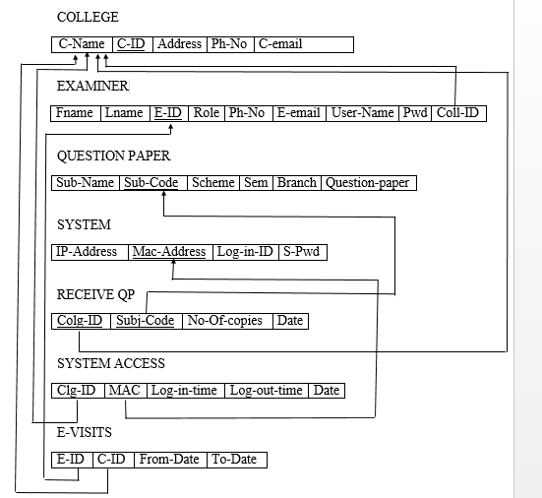
Schema Diagram

Slide 9
Operation On Database
Insertion
Updating
Deletion
Trigger
Stored Procedure

Slide 10
HARDWARE REQUIREMENTS
Processor - 1 GHz and above.
RAM - 2GB
Hard Disk - 40 GB

Slide 11
SOFTWARE REQUIREMENTS
Operating System - Windows
Technology - Java and J2EE
IDE - Net Beans
Database - MySQL
Java Version - J2SDK1.5

Slide 12
Snap Shots

Slide 13
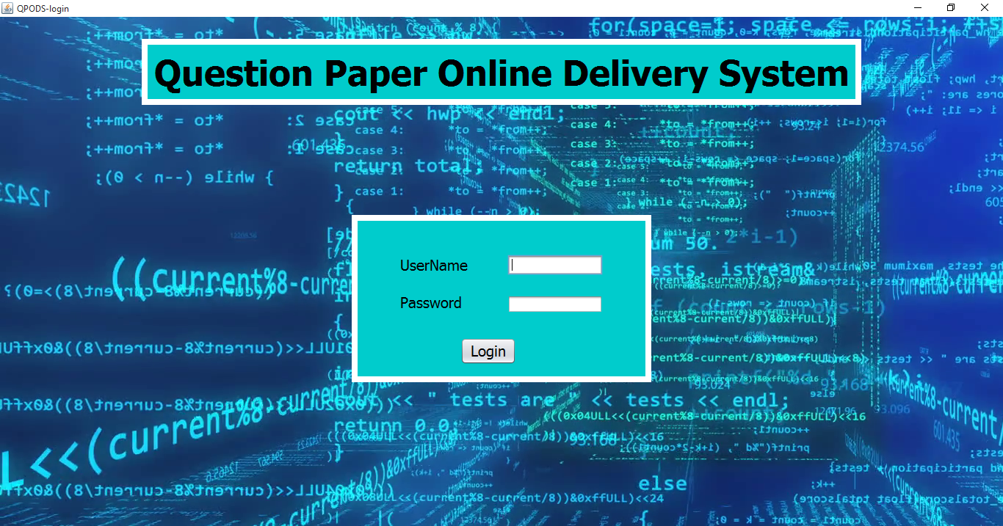
Login for Admin

Slide 14
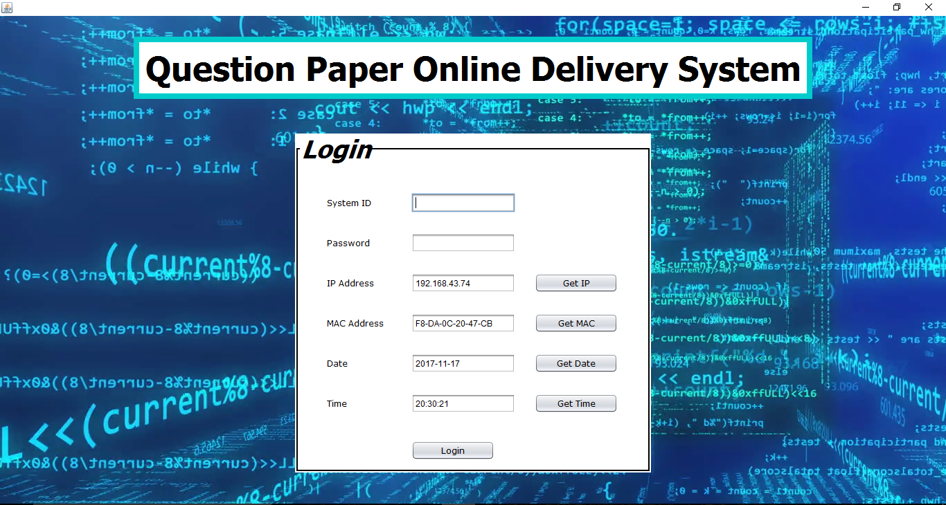
Login page for user

Slide 15
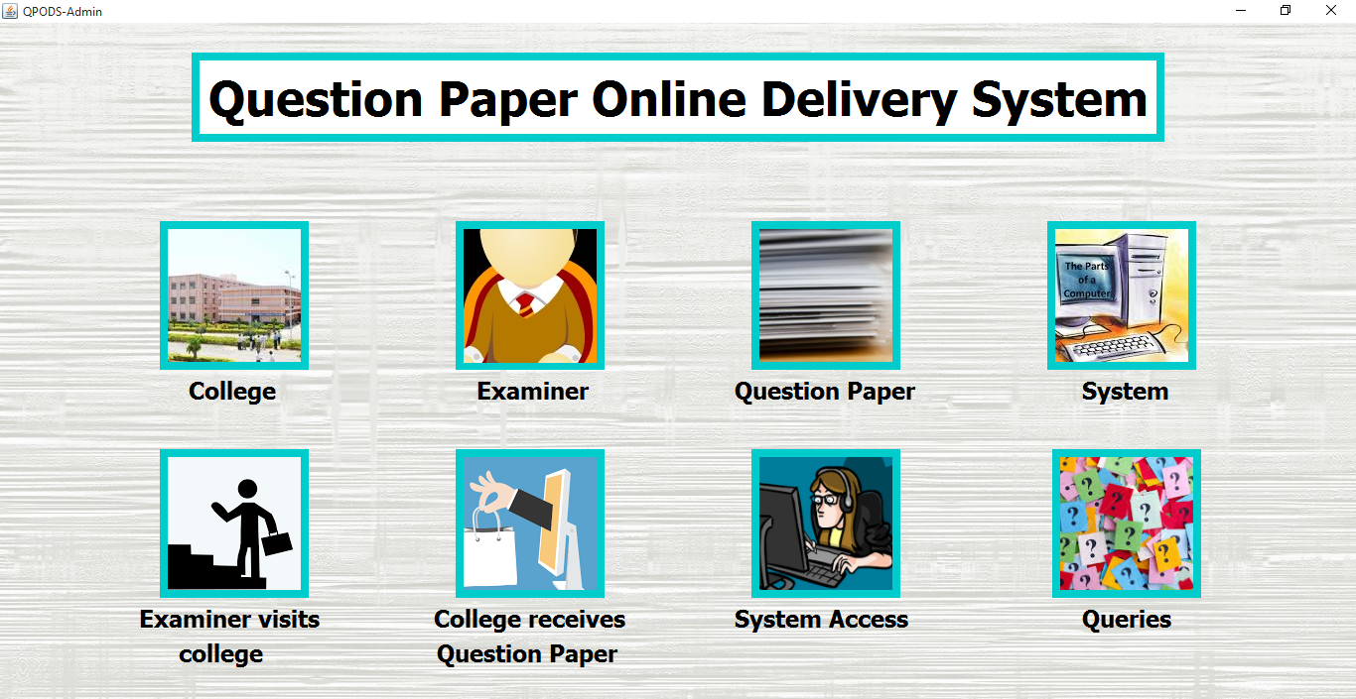
Home

Slide 16
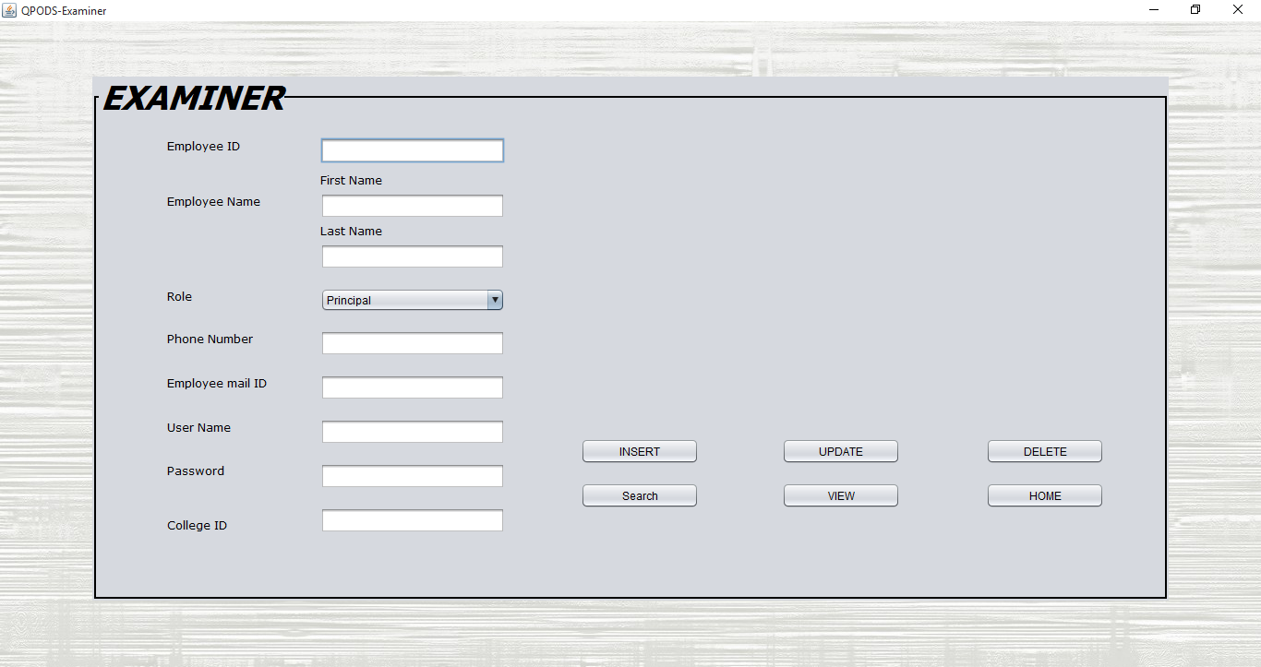
Examiner

Slide 17
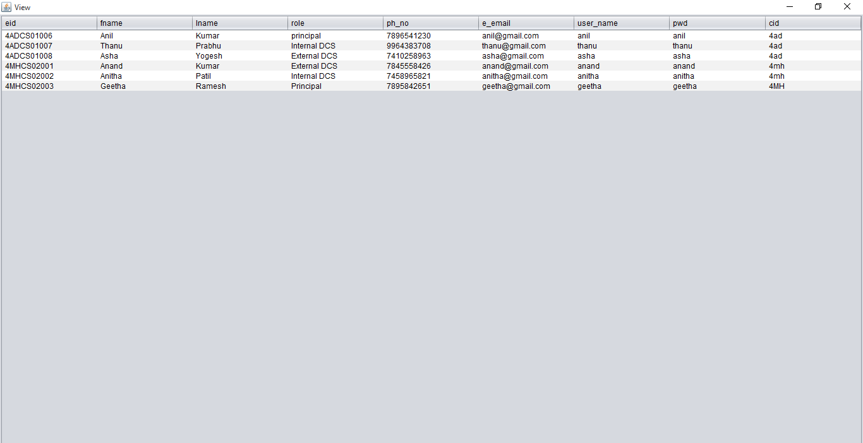
Table View of Examiner

Slide 18
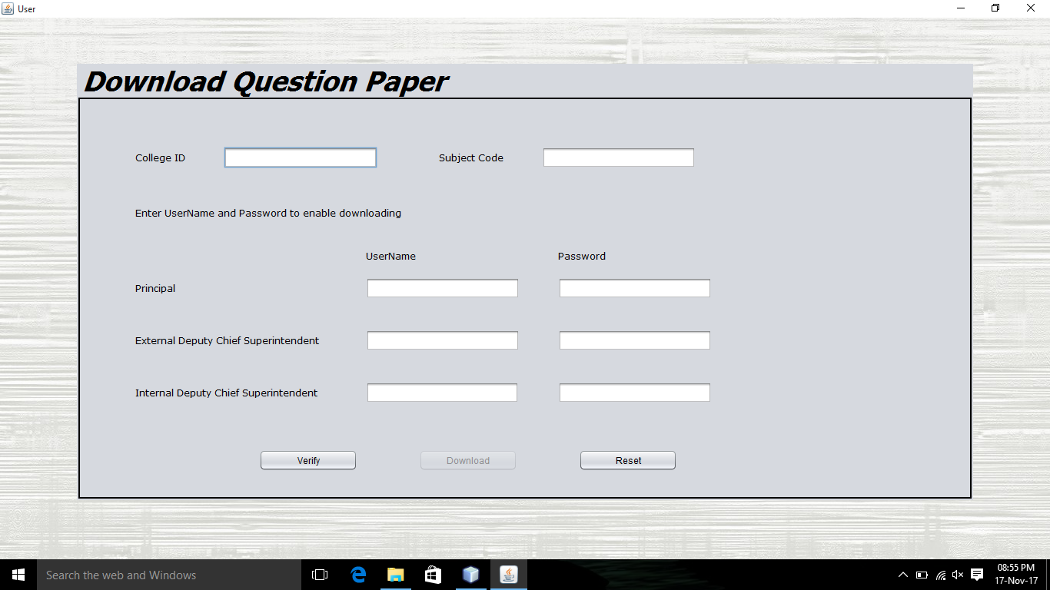
Download Question Paper

Slide 19
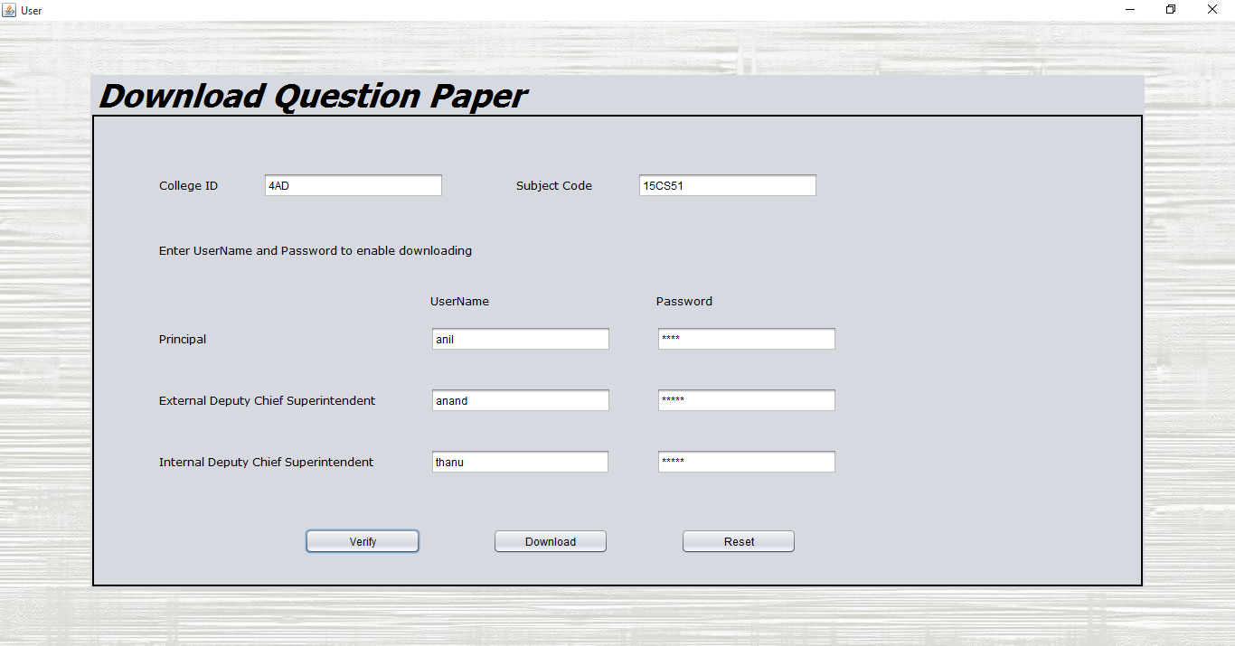
Download Question Paper

Slide 20
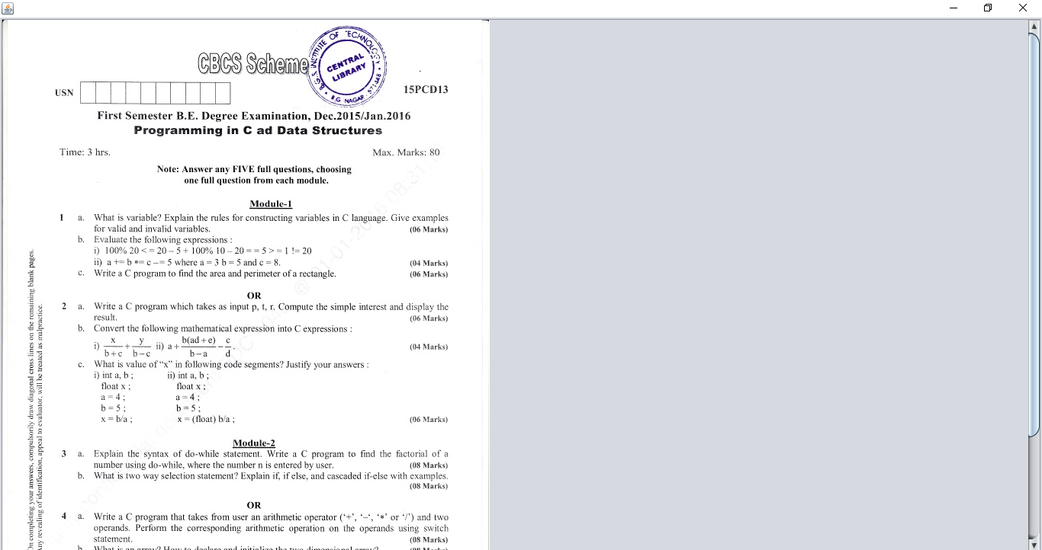
Downloaded Image Of Question Paper

Slide 21
CONCLUSION
This project enables secure transmission of question paper over online

Slide 22
REFERENCES
VTU will experiment with online delivery of question papers this year – The Hindu
http://www.thehindu.com/news/cities/bangalore/vtu-will-experiment-with-online-delivery-of-question-papers-this-year/article3299446.ece
VTU online question paper delivery system best option to prevent leakages
http://timesofindia.indiatimes.com/city/hubballi/VTU-online-question-paper-delivery-system-best-option-to-prevent-leakages/articleshow/51716129.cms
Question Paper Delivery System (Q PDS) – Online Delivery of Question papers.
https://medium.com/three-much/question-paper-delivery-system-qpds-online-delivery-of-question-papers-6de18831701
Online question paper delivery system
https://mbcet.wordpress.com/tag/online-question-paper-delivery-system/
VTU to adopt online question paper delivery system
http://www.thehindu.com/todays-paper/tp-national/vtu-to-adopt-online-question-paper- delivery-system/article3444017.ece

Slide 23
THANK YOU

